Slide 1

Understanding AN Explainable Intelligence Driven Balanced Decision Tree Approach
For Psychological Disorder Assessment
Presentation by:
Souvik Naskar
Rajdeep Mallick
Arup Kumar Roy
Under the guidance of:
Prof. Sruti Gan Chaudhuri
Jadavpur University

Slide 2

INTRODUCTION
The World Health Organization (WHO) highlights the importance of mental health disorders like anxiety, stress, and depression, which are emerging due to personal and professional instabilities. These disorders often have overlapping symptoms and require proper attention. Accurate assessment and treatment are challenging tasks for machines, and explainable intelligence is needed to improve the implementation capability of predictive learning methods.

Slide 3
Problem statement
Developing an explainable intelligence-driven predictive model to accurately detect and differentiate anxiety, stress, and depression within accumulated online questionnaires, addressing the trade-off between predictive ability and transparency for improved patient mental stability.

Slide 4
related works & PROBLEMS
ML Models Employed:
Various models (e.g., random forest, neural network, decision tree, CNN) utilized for disorder prediction.
Dataset Analysis and Model Evaluation:
Evaluation and comparison of ML model performances for mental health prediction.
Utilization of diverse datasets (e.g., Twitter, DASS 21, PHQ-9) for training and testing.
Diagnostic Accuracy Enhancement:
Focus on achieving high precision and accuracy rates in diagnosing psychological disorders.
Implementation of diverse ML techniques to refine diagnostic precision.

Slide 5
RELATED WORKS & PROBLEMS
Problems:
Small Sample Size:
Challenge for several deployed models.
Limits the effectiveness of the models due to insufficient data.
Black-Box Predictions:
Most predictive intelligent models provide black-box predictions without reliable justified explanations.
Lack of interpretability creates ambiguities in understanding and reasoning about mental health risk predictions
Explanatory Interface Requirement:
The absence of reliable, justified explanations in predictive models necessitates the need for an explanatory interface.
Proper interpretation of psychological health prediction outcomes is crucial for user understanding and trust in the model.

Slide 6
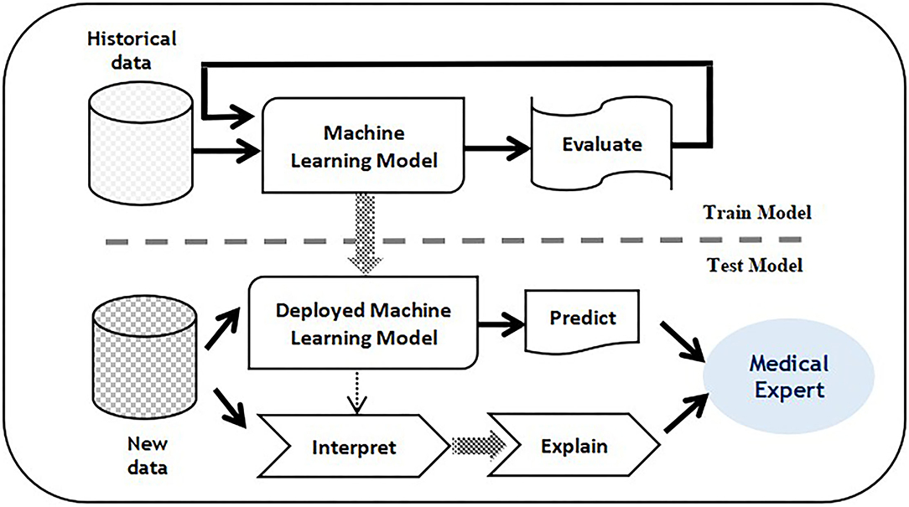
Overview of the explainable predictive model

Slide 7
METHODOLOGY
Recognizing physiological disorders (anxiety, stress, depression) using an explainable intelligence-based predictive model. The framework phases are :
Transform-Encode : Convert raw data to an interpretable template.
Segregate-Label : Partition data attributes into anxiety, depression, and stress sets.
Q-Prioritization : Eliminate less significant queries or attributes.
Train-Test : Learn from examples using a machine intelligence algorithm.
Prediction Interpret : Provide explanations for prediction outcomes.
Validate : Comprehensive psychological assessment.

Slide 8
Transform encode phase & SEGREGATE LABEL PHASE
Transform-Encode Phase :
Missing responses are removed, outliers tagged, and responses encoded based on severity.
Final rate points are on [0,3] scale for analysis.
Segregate-Label Phase :
Attributes categorized into anxiety, depression, and stress sets based on belonging values.
Five levels (Normal, Mild, Moderate, Severe, Extremely Severe) considered for each disorder.
Weight Score (WS) computed by summing up rate points to assess disorder severity.

Slide 9
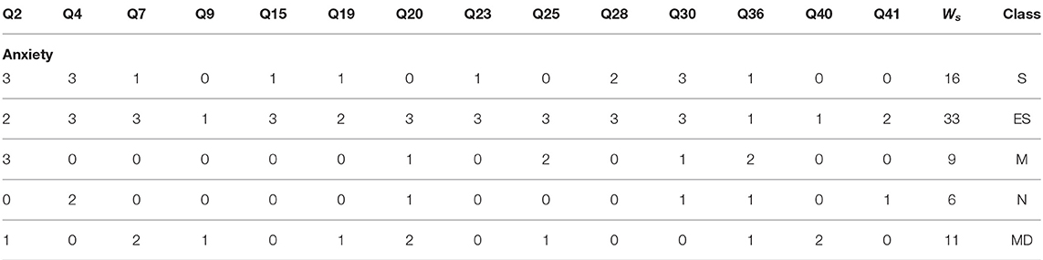
TRANSFORM ENCODE PHASE​ & SEGREGATE LABEL PHASE​
DASS (42) Scoring | Depression | Anxiety | Stress
Normal | 0-9 | 0-7 | 0-14
Mild | 10-13 | 08-09 | 15-18
Moderate | 14-20 | 10-14 | 19-25
Severe | 21-27 | 15-19 | 26-33
Extremely Severe | 28+ | 20+ | 34+

Slide 10
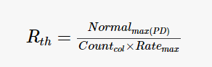
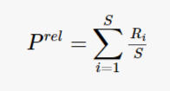
Q-Prioritization Phase
Eliminates less significant queries or attributes from the pre-processed dataset.
R-th Determination : Computes relevant thresholds for anxiety, stress, and depression.
Priority Relevance : Calculates attribute priority based on the ranking of mean values

Slide 11
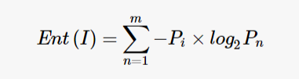
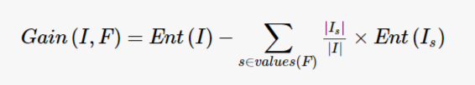
TRAIN TEST PHASE
Once the irrelevant attributes in the dataset are eliminated, it is all set to learn through examples using an appropriate machine intelligence algorithm.
Entropy in information theory is a metric that exhibits the purity of a random dataset.
Information gain is a statistic based method for the selection of suitable attributes for testing at every node.

Slide 12
Prediction interpret phase
Our model sheds light on predictions by scoring attributes based on their impact. This score reflects how much each factor influences the outcome. Three methods for deeper insights:
Permuted Feature Importance Method : Randomly scramble values to see how important an attribute is.
Contrastive Explanation Method : Compare similar cases with different outcomes to find key differences.
Counterfactuals Method : Imagine changing features and see how the prediction shifts, like a thought experiment.

Slide 13
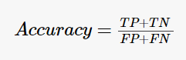
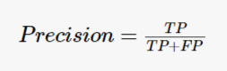
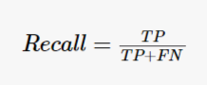
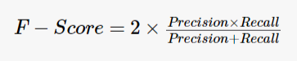
VALIDATE PHASE
Evaluating the model's accuracy and effectiveness.
Performance metrics :
Accuracy: Overall correct predictions
Precision: Correct positive predictions
Recall: True positive predictions
F-score: Combine precision and recall for balanced view
MSE: Difference between original and predicted values

Slide 14
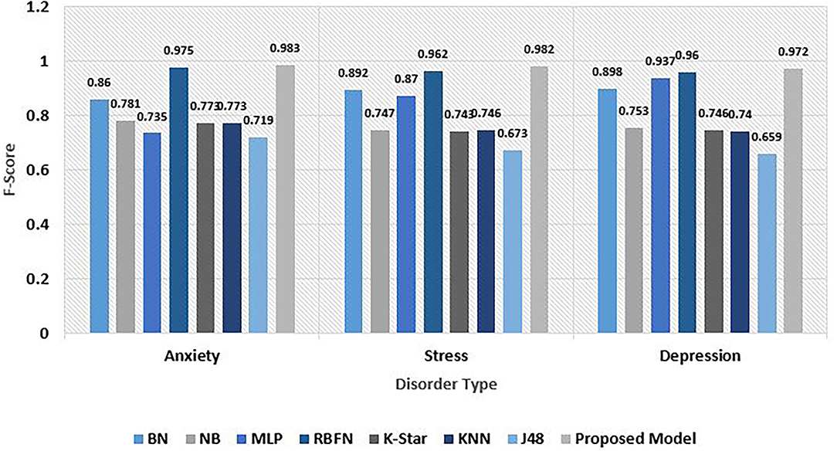
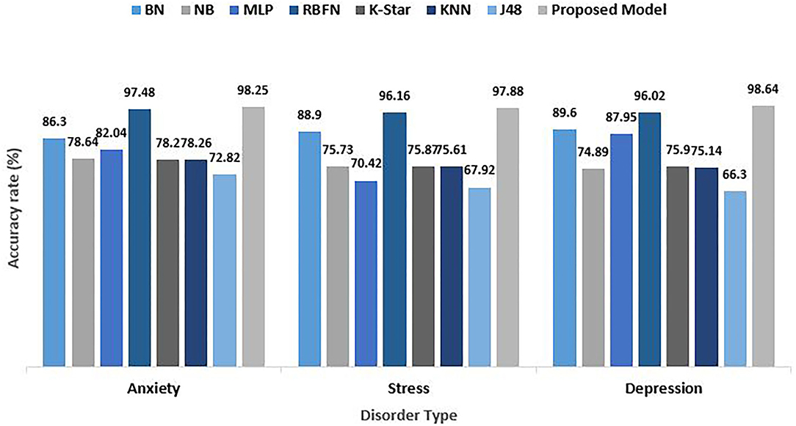
comparative analysis for psychological risks

Slide 15
Our Implementation and Findings
1. Dataset Overview
For performance evaluation, we employed the standard DASS 42 questionnaire dataset.
Notably, our dataset comprises a larger scale, encompassing a total of 33,281 unique responses, a significant expansion compared to the 13,000 responses utilized in the referenced research work.
2. Data Preprocessing
Executed the Transform-Encode Phase and Segregate-Label Phase, aligning with the methodology discussed earlier.
3. Feature Selection
Explored Q-prioritization, feature variance, and Information gain methods for feature selection.
Despite initial attempts, feature selection led to an overall reduction in model performance.

Slide 16
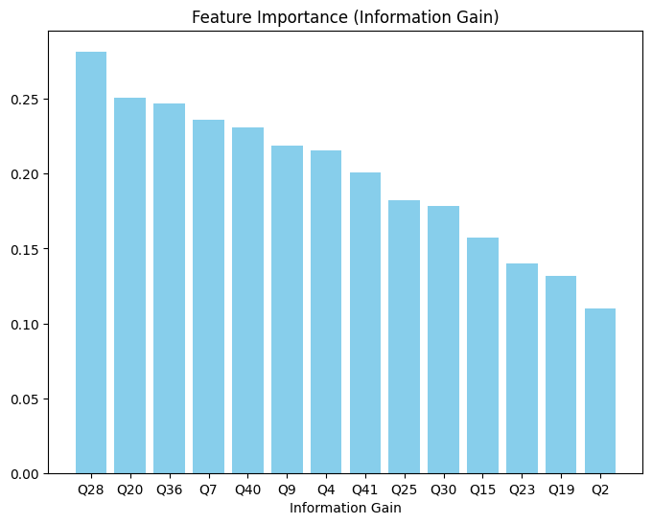
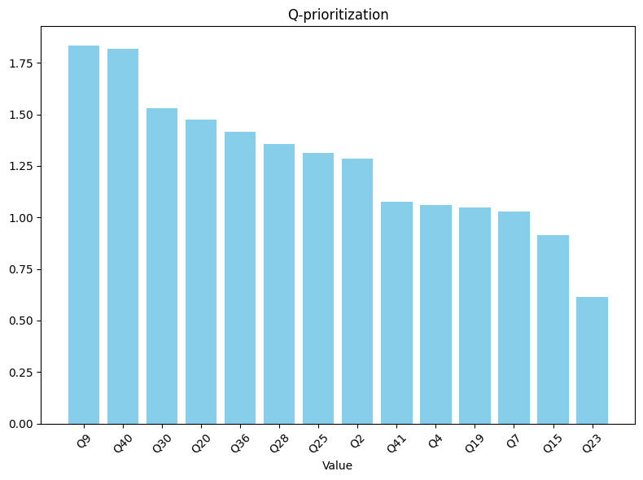
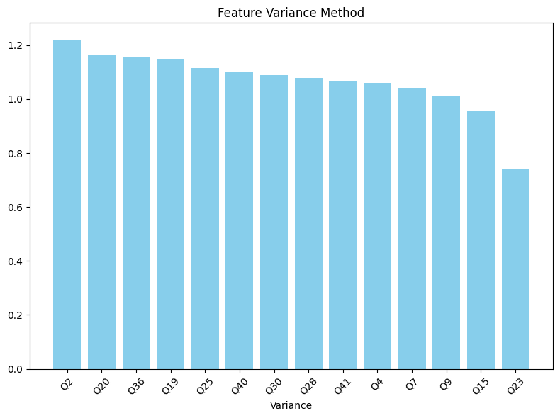
Our Implementation and Findings
Feature Selection For Anxiety Data
Query “Q23” was found to be less relevant in the anxiety set and was dropped from the data set.
Upon removing "Q23," the accuracy decreased by approximately 0.4%.

Slide 17
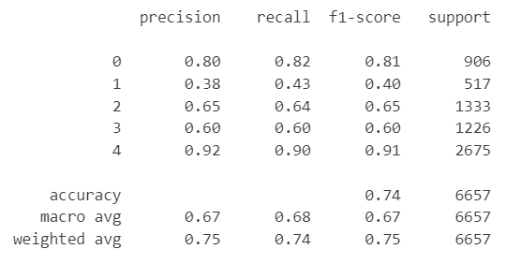
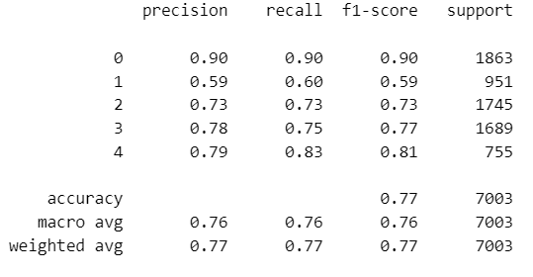
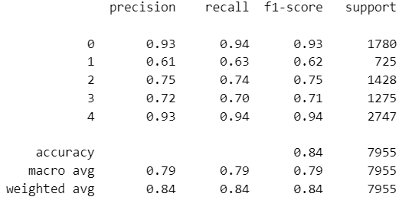
Our Implementation and Findings
4. Addressing Class Biasness
Applied oversampling techniques, specifically using RandomOverSampler, to mitigate class biasness.
5. Model Selection and Training-Testing
Employed GridSearchCV for hyperparameter tuning in the decision tree model.
Anxiety
Stress
Depression
Classification Reports For Decision Tree Model

Slide 18
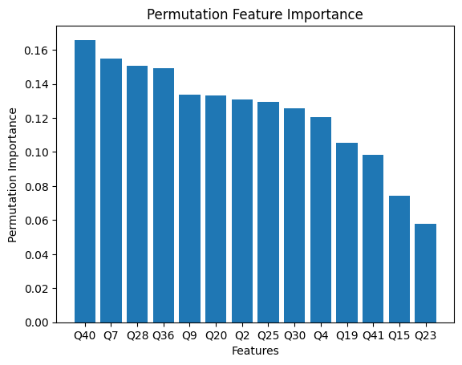
Our Implementation and Findings
6. Interpretation Phase
Utilized CEM (Counterfactual Explanations Method) and Permuted Feature Importance Method in the interpretation phase for decision tree model.
Decision Tree Model (Anxiety Data)

Slide 19

Limitations and FUTURE WORK
Model accuracy for anxiety, stress, and depression is lower than claimed; analysis needed.
Q-prioritization reduces accuracy; reasons require investigation.
Counterfactual Method implementation pending; CEM and Permuted Feature Importance in place.
Consideration of other ML algorithms like SVM and MLP for potential improvements.

Slide 20

references
Frontiers research article for Multi-Level Psychological Disorders Assessment: https://www.frontiersin.org/articles/10.3389/fpubh.2021.795007/full
Depression Anxiety and Stress Scale (DASS) report: https://www.healthfocuspsychology.com.au/tools/dass-42/
Contrastive Explanations Method for Model Interpretability: https://arxiv.org/abs/2103.01378
scikit-learn: https://scikit-learn.org/stable/index.html
Our work
Google Drive link: https://drive.google.com/drive/folders/19lXQKv7Wtov-EjzV0Ljfc2QiwrOHCbKR?usp=sharing

Slide 21


